Slide 1



IOT BASED VISITOR SENSING DOOR WELCOME MAT
BY:
SANCHANA SRI S

Slide 2
LIST OF CONTENTS
INTRODUCTION
PROBLEM STATEMENT
OBJECTIVE
BLOCK DIAGRAM
EXISTING SYSTEM
PROPOSED SYSTEM
COMPONENTS
WORKING PRINCIPLE
CONCLUSION
REFERENCES

Slide 3
INTRODUCTION
Over the last decade, different studies have been carried out to increase security. we have made an project which notifies you when any guest or visitor steps at doormat. For that we use IR sensors that detects the human with their temperature and sends a notification to the users mobile. So whenever any Visitors arrive there is no need of any doorbell ,the doormat can automatically detect visitor and notify on their behalf. It’s not only a doormat, either. It’s a weight touchy layer of smart foam that you can set under your doormat or practically anyplace in your home you need pressure-sensitive responses.

Slide 4
PROBLEM STATEMENT
In today's fast-paced world, home security and convenience are paramount concerns for homeowners. Traditional doorbells and security systems may not provide the level of sophistication and integration required to enhance both security and hospitality. The challenge is to create an innovative and cost-effective solution that combines IoT technology with a welcome mat to intelligently detect and welcome visitors while ensuring the safety and convenience of homeowners.

Slide 5
OBJECTIVE
The main objective of this project is to Alert the user and protect them from being theft. By using our project, we can prevent the people from robbery and being injured. Proposed system helps in urgent situation condition, by alerting the user by sending a notification to the user.

Slide 6
BLOCK DIAGRAM
POWER SUPPLY
IR
IR SENSOR 1
RELAY MODULE
NODE MCU
ESP8266
IR SENSOR 2

Slide 7
EXISTING SYSTEM
The existing system has many methods to detect the theft activities , In before there was a system for this it will only buzzer when someone steps on the smart doormat. But it cannot able to identify whether it was a human or animal steps on it.In this application it will only alert the user by using the buzzer. Nowdays people goes to work in early and returns in late night they cannot able to in house all the time .so we have developed this Iot based smart doormat.

Slide 8
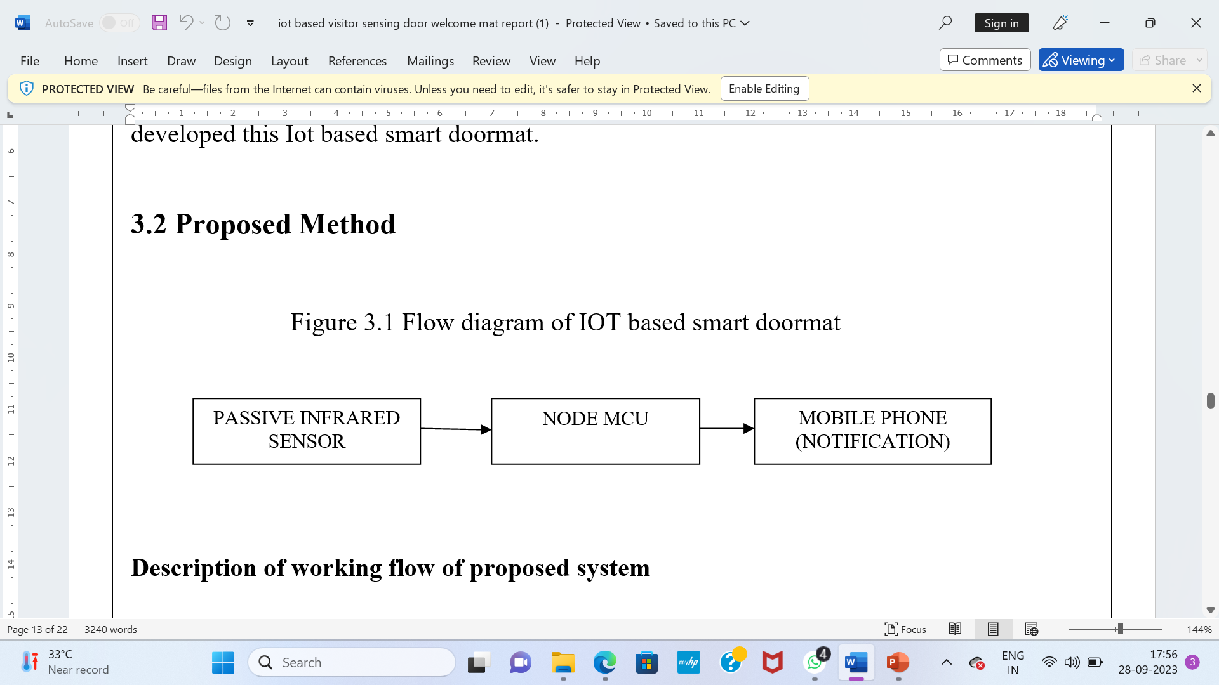
PROPOSED SYSTEM

Slide 9
COMPONENTS
NODE MCU(ESP 8266)
IR SENSOR
RELAY UNIT
BC 547
RESISTORS
POWER SUPPLY
MAT

Slide 10
WORKING PRINCIPLE
In this IOT based visitor sensing door mat, we have considered the project which notifies you when any guest or visitor steps(cross over) the door mat .For this purpose we here use PIR sensor that sense infrared ray in order to sense the human. Which then alerts the user by sending a notification. The PIR sensor sense the human infrared ray and sends the notification to the user’s mobile phone through IOT module(Node mcu).

Slide 11

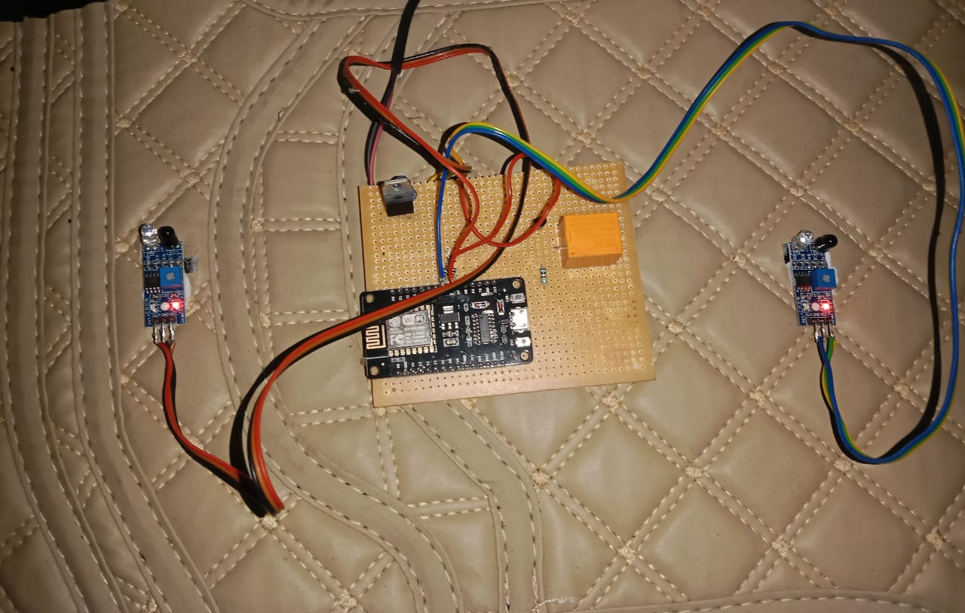

Slide 12
CONCLUSION
This project is the solution to help the people from theft and robbery. This system will alert the people by using notification when the stranger tries to enter the home .This IOT based visitor sensing door welcome mat is the device when a stranger tries to attempt the house it will send a notification to user and by using this system we can help the society from thieves.

Slide 13
REFERENCES
[1]. Akhil Menon, Prashant Singh, Pramit Yadav Preeti Godabole, "Communication over Internet and GSM using Smart Doorbell," IJSRD - International Journal for Scientific Research & Development|, vol. 4, no. 1, 2016.
[2]. Tolga Karalar Burak Sarp, "Real Time Smart Door System for Home Security," International Journal of Scientific Research in Information Systems and Engineering (IJSRISE), vol. 1, no. 2, Dec 2015.
[3]. E.M.C Wong, "A Phone-Based Remote Controller for Home and Office Automation," IEEE Transactions on Consumer Electronics, vol. 40, no. 1, pp. 28-34, Feb 1994.
[4]. Md. Shiblee Nooman, Srijon Sarker Md. Nasimuzzaman Chowdhury, "Access Control of Door and Home Security by Raspberry Pi Through Internet," International Journal of Scientific & Engineering Research, vol. 4, no. 11, Nov 2013.

Slide 14



